Slide 1
Peter comments
Keep audience in mind (mostly not bioinformaticians)
~10 minutes introduction to set up story/gain interest
Add quadrant irAE/OR figure from grant, this highlights a central goal/Q: can we distinguish OR from irAE development (difficult as they may correlate), this is missing from intro currently (problem: keeping response while reducing irAE, hard if they correlate)
Only show stuff if discussing it
Verbally share that literature has explored since we started collecting samples
Goals: add in predicting response from baseline immunotypes (and ofc we won’t have results today/yet no metadata for response) but that’s a main goal we’re interested in
Re-share slides Tuesday!
9

Slide 2
Identifying immune cell subsets associated with immune-related adverse event (irAE) development
12-19-2024
Ty Bottorff – Bioinformatics postdoc
Linsley lab
1

Slide 3

Acknowledgements
Peter Linsley
Long lab/HIPcore
Alice Long, Alice Wiedeman
Holly Akilesh
Buckner lab
Jane Buckner, Sylvia Posso, Cliff Rims
Bernard Khor
Bioinformatics
Hannah DeBerg
Basilin Benson
Andrew Koval
Clinical teams at VM, SCCA, & the University of Texas
2

Slide 4
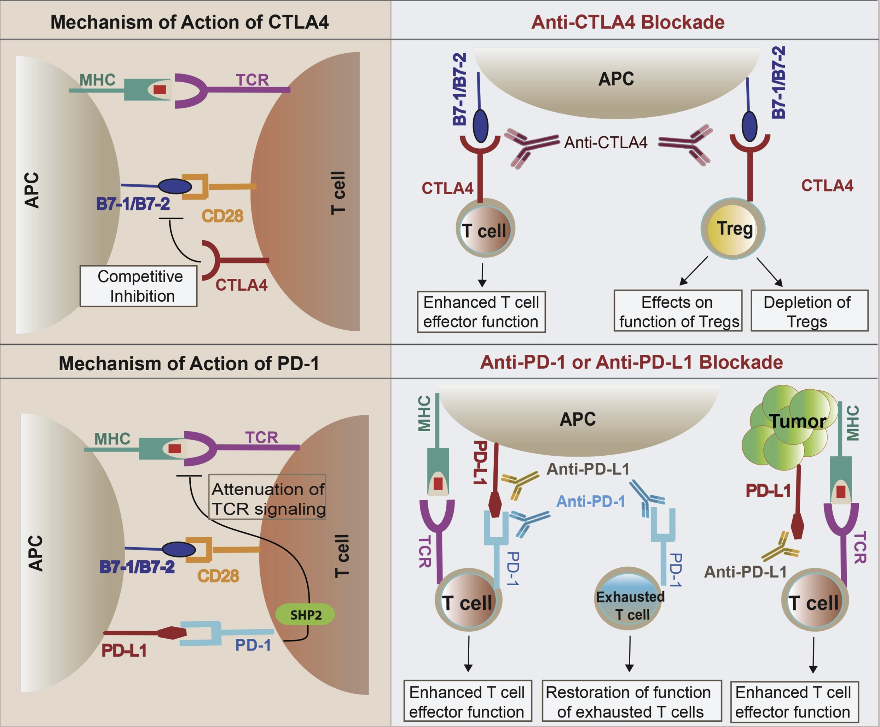
Immune checkpoint inhibitors (ICIs) have revolutionized cancer treatment
3
Khan et al. Semin Cancer Biol. 2020
Notes:
ICIs block inhibitory molecules that regulate T cells, releasing tumor-specific T cells to destroy tumor targets
Clinical success of ICI, but only effective in some patients (~20-50% response rates)

Slide 5
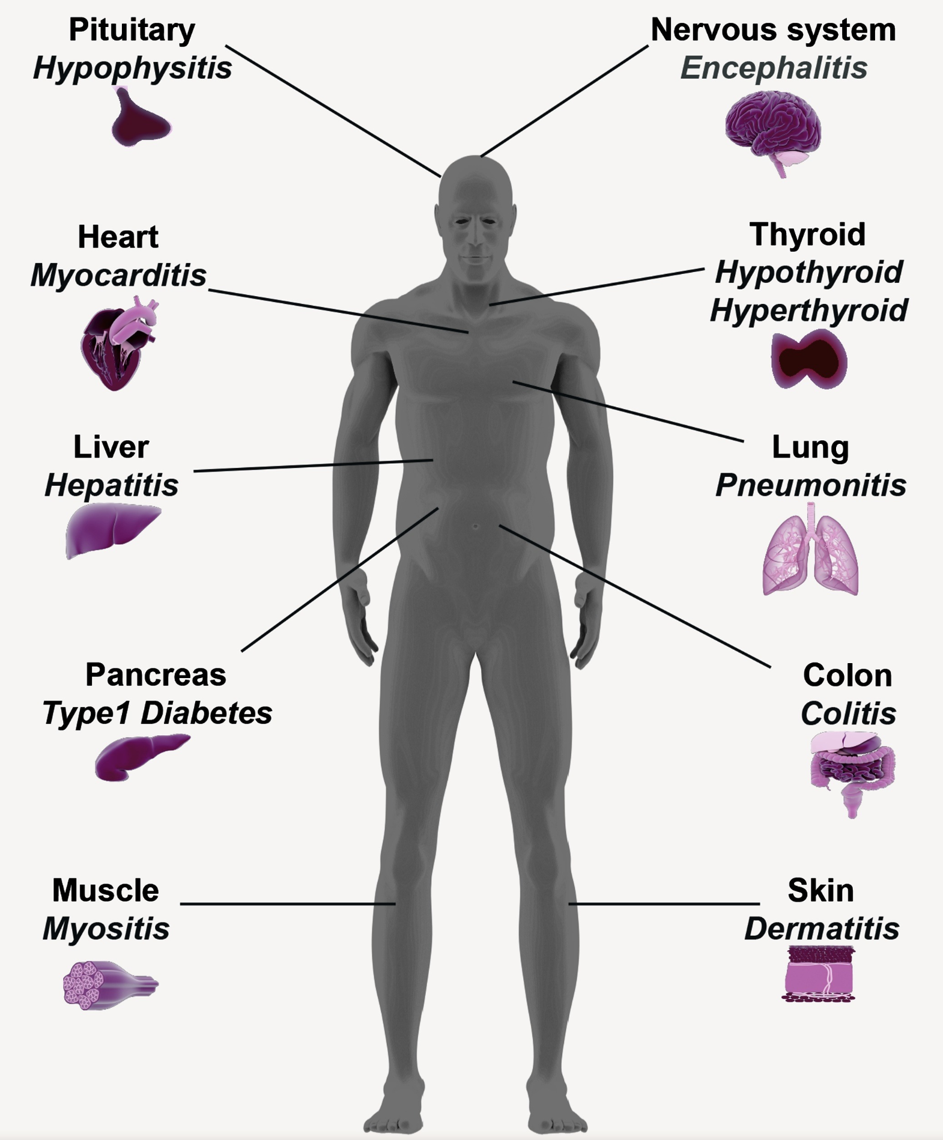
However, ICIs can lead to the development of immune-related adverse events (irAEs)
4
Khan et al. Semin Cancer Biol. 2020
Notes:
However, ICIs also release self-specific T cells to destroy self-targets (breach of self-tolerance), resulting in irAEs, autoimmune-like inflammatory pathologies (more transient, faster kinetics than autoimmune conditions)
irAEs are heterogeneous (organ-target), and have sometimes been associated with favorable response to ICI
irAEs affect quality of life AND can necessitate discontinuation of ICI which prevents full benefit of ICI therapy
heterogeneity amongst irAE organs likely complicates prediction
individuals with preexisting autoimmune disease flare when treated with ICI

Slide 6
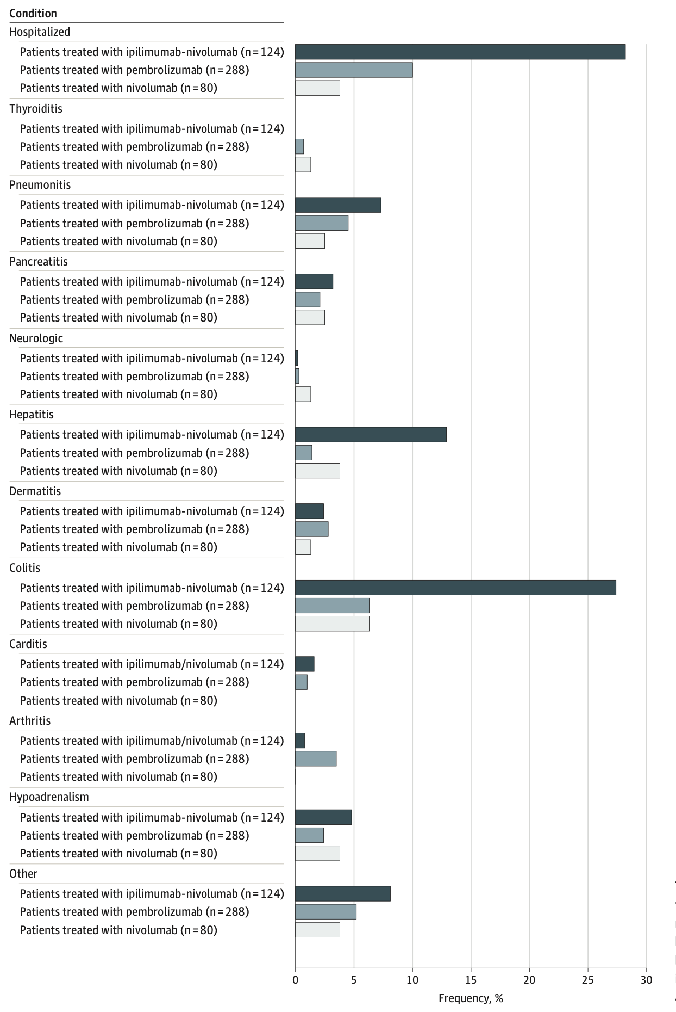
irAEs are rather common
Need alternative figure/at least highlight
irAEs I discuss later
5
Watson et al. JAMA Netw Open. 2022
Notes:
Autoimmune toxicity occurs in up to 60% of patients treated with immune checkpoint inhibitor (ICI) therapy
Ipilimumab: CTLA-4
Pembrolizumab/nivolumab: PD-1

Slide 7
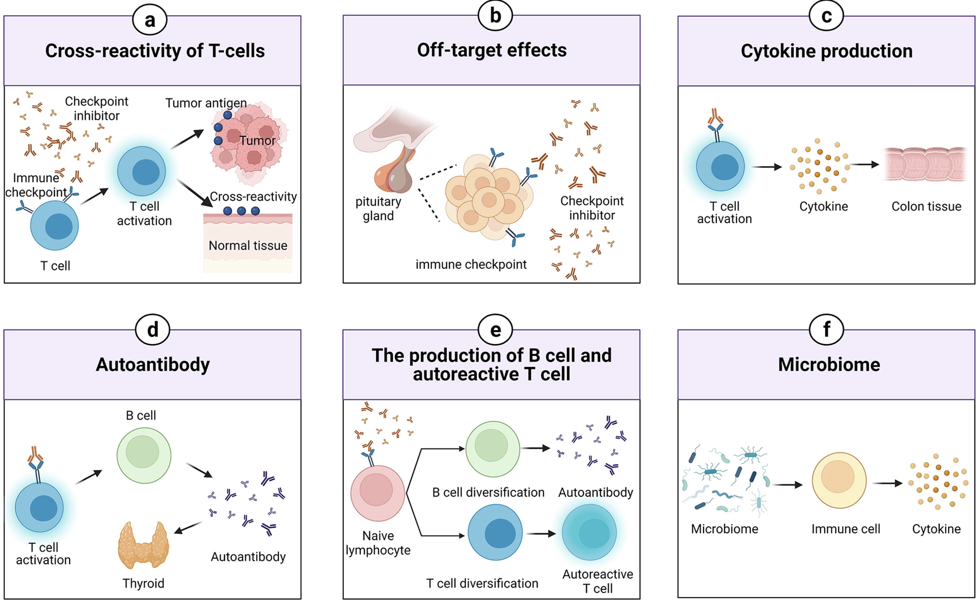
irAEs may be driven by multiple, possible mechanisms
6
Zheng et al. Materials & Design. 2022
Notes:
Shared antigens between tumor and self → cross-reactivity
Some tissues directly express immune checkpoint ligands (moreso for pituitary expression of CTLA-4)
Activated T cells can release inflammatory mediators that can damage normal tissues
Autoantibody production associated with irAE risk (autoantibodies present ~50% of time for irAEs)
ICIs can induce more diverse T/B cell repertoires as well as promote their activation/proliferation
T cells absolutely implicated in irAE development (clonal expansions of CD8s prior to severe irAEs)
Premise: T cell responses to tumor and autoantigens are predictive of response to ICI therapy and/or irAE, supported by 1) published studies showing that ICI therapy targets T cells and 2) emerging evidence that ICI therapy reverses T cell exhaustion
Certain microbiome species can shift immune response to pro/anti-inflammatory to induce/resist irAEs

Slide 8
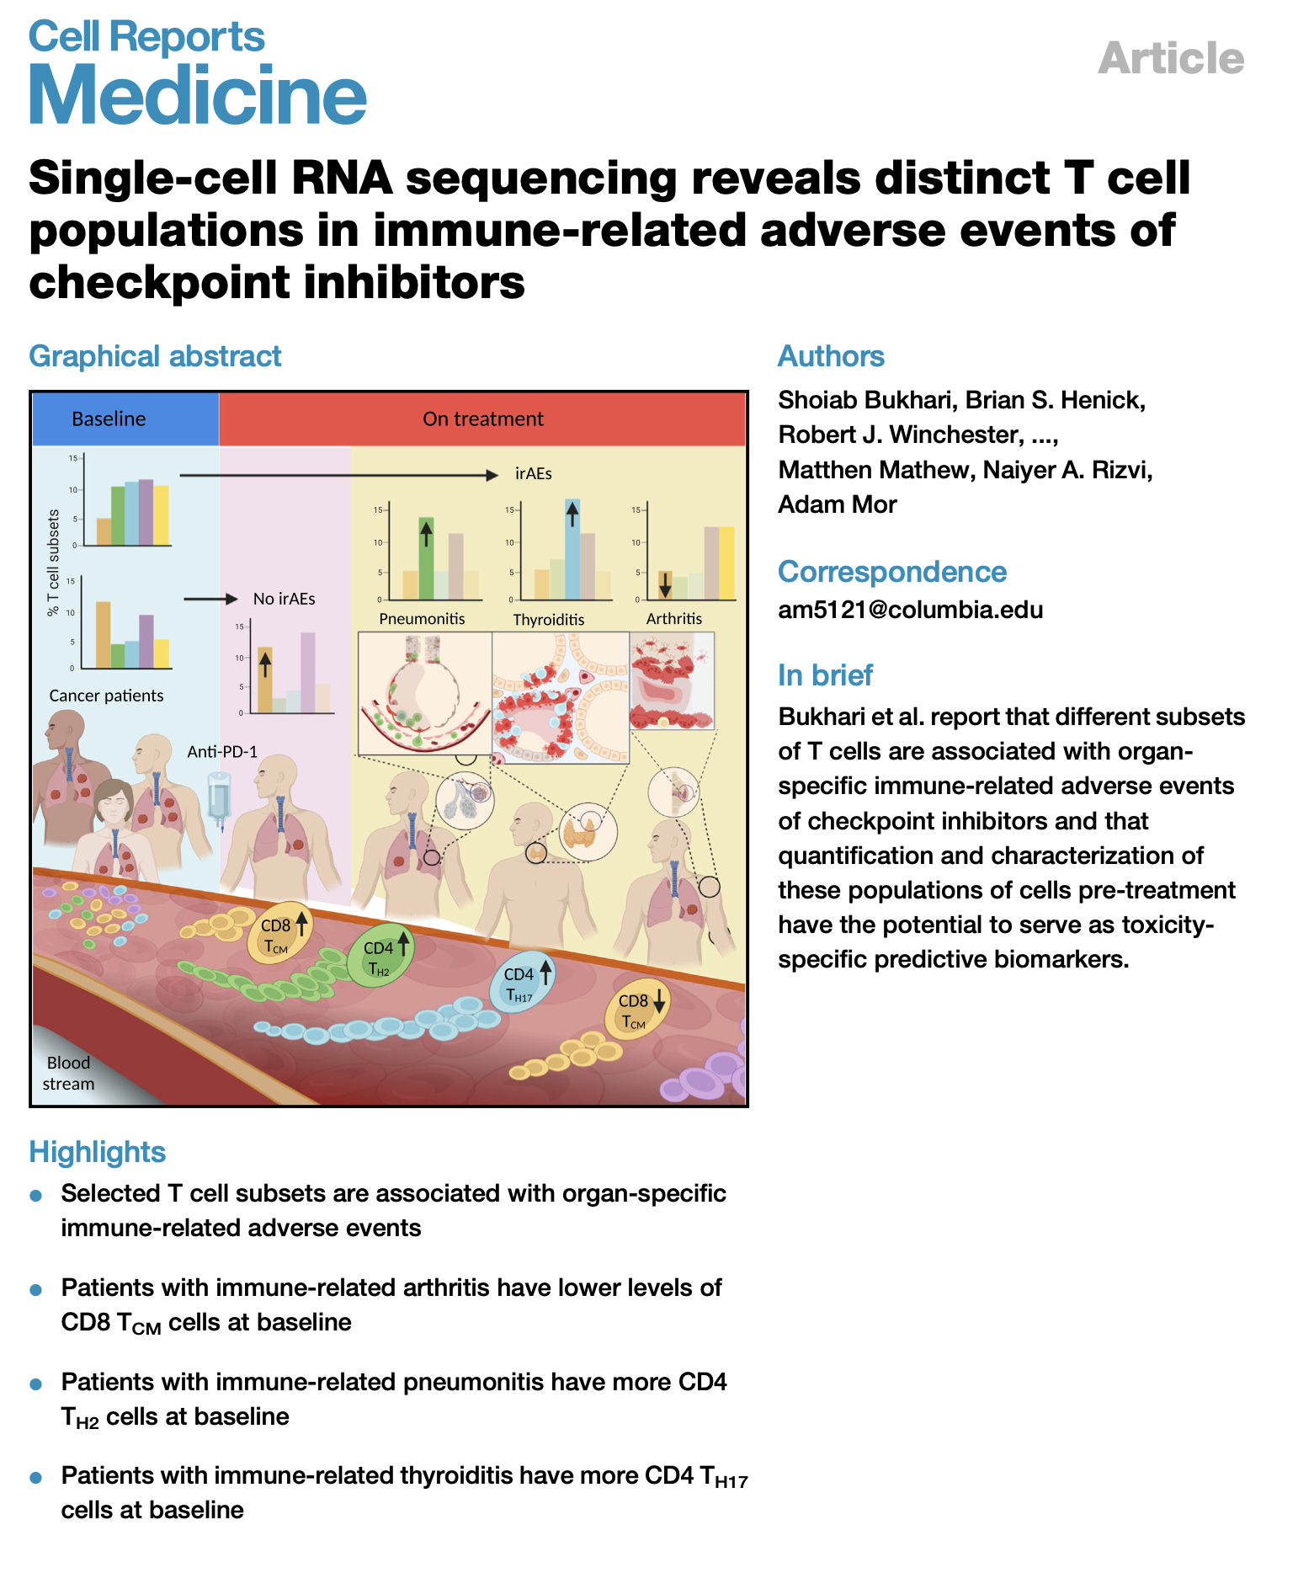
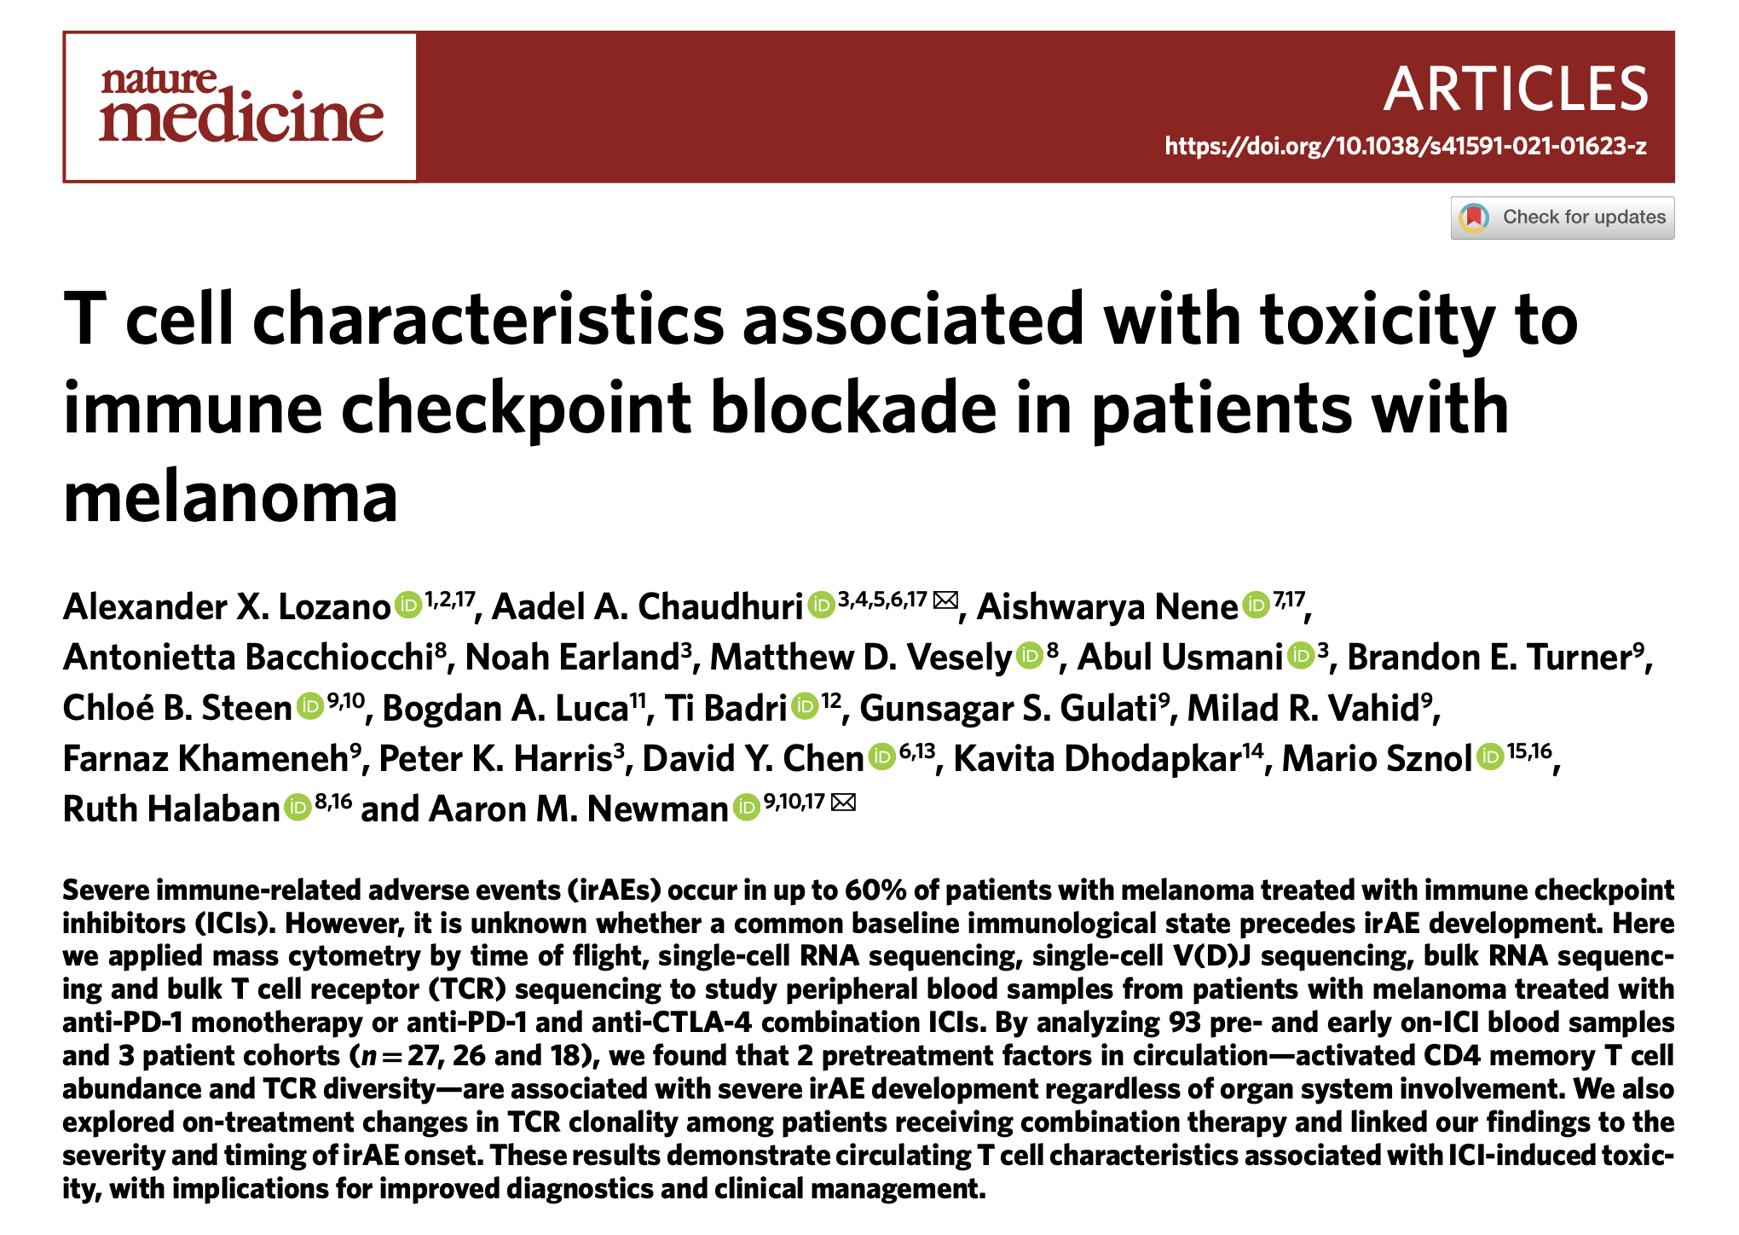
Baseline abundances of different cell types have been associated with irAE development
7
Notes:
heterogeneity amongst irAE organs likely complicates prediction
T cell characteristics associated with toxicity to immune checkpoint blockade in patients with melanoma: BASELINE activated CD4 effector memory T abundance and TCR diversity associated with irAE
Different subsets maybe are irAE-type-specific due to different immune microenvironments of different organs

Slide 9
Main goals
Identify immune cell biomarkers that predict irAEs
Determine how ICI alters immune cell landscape
9

Slide 10
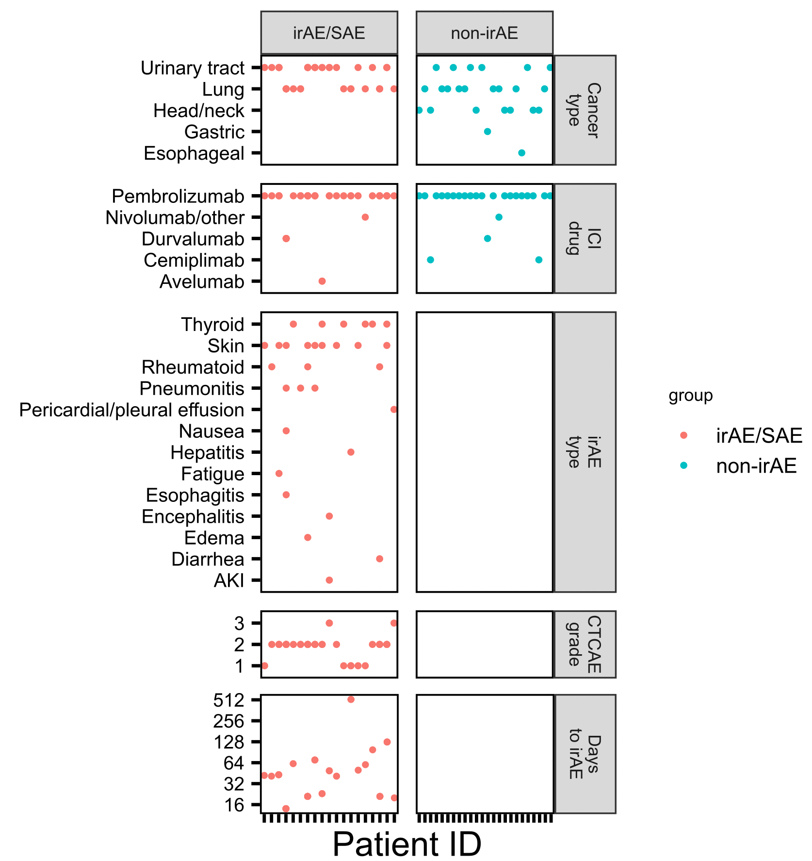
ICI cohort
mostly lung/urinary tract primary cancers
almost exclusively treated with anti PD-1
skin, thyroid irAEs well-represented
most irAEs arise within 1-2 months
Acknowledge clinical teams at 3 institutions here (VM, SCCA, U. of Texas)
Cancer really what was available (not much
Melanoma across street at VM) +
Had approved therapy of PD-1 blockade
+ able to get large group size
Lung approved 2nd after melanoma for PD-1 blockade
Drugs chosen by clinic (combination mostly for melanoma/more side effects too)
10
Notes:
Focused on lung/bladder cancer (carcinogen-related cancers with common etiologic risk factor [tobacco use] and are treated with single class of checkpoint inhibitors as established standard of care due to durable responses, remissions, improvements in survival)
Durvalumab/avelumab are anti-PDL1

Slide 11
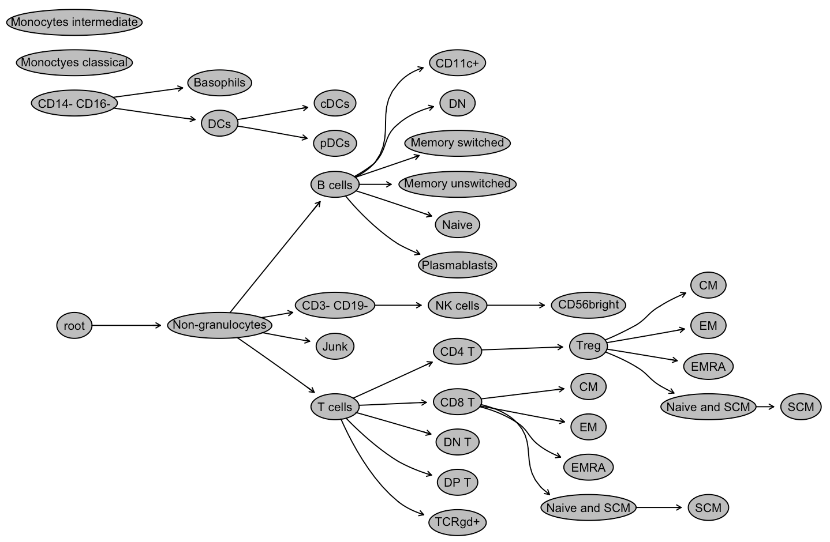
Analyzing immune cell populations in the periphery CyTOF
Broad subsets (T, B, NK, monocytes…)
Memory subsets of T/B cells
Special CD4/CD8 subsets
PD1⁺ T/B/NK, PDL1⁺ (monocytes)
Was frozen PBMCs, verbally share that sample collection was a group effort by a lot of people,
They collected blood from patients and froze down PBMCs
Acknowledge Alice W. here
Make it clear I was handed dataset
Also need slide on how she made data (gating…
% of parent)
11
Notes:
Calling these population subsets subsets for rest of talk
Mass cytometry
80 reportables* (FlowJo, Alice Wiedeman)
Alice used Astrolabe cytometry cloud platform

Slide 12
Main goals
Identify immune cell biomarkers that predict irAEs
Determine how ICI alters immune cell landscape
12
Notes:
hypothesis that ICI-induced irAEs, similar to flare-ups in patients with primary autoimmunity, are symptomatic exacerbations that occur in the context of a baseline dysregulated immune state unleashed by ICI treatment.
Specifically T cells: hypothesize that freq/phenotype of T cells specific for self-antigens predicts irAE. supported by 1) published studies showing that ICI therapy targets T cells, 2) emerging evidence that ICI therapy reverses T cell exhaustion

Slide 13
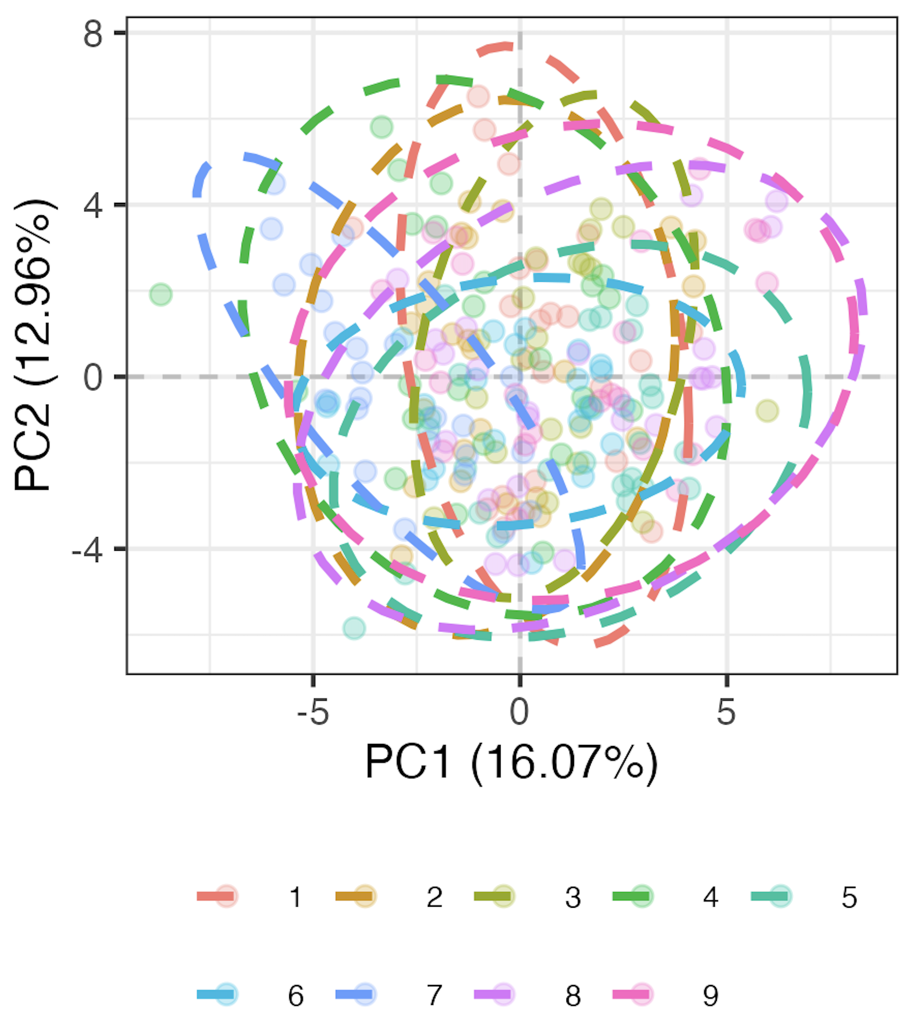
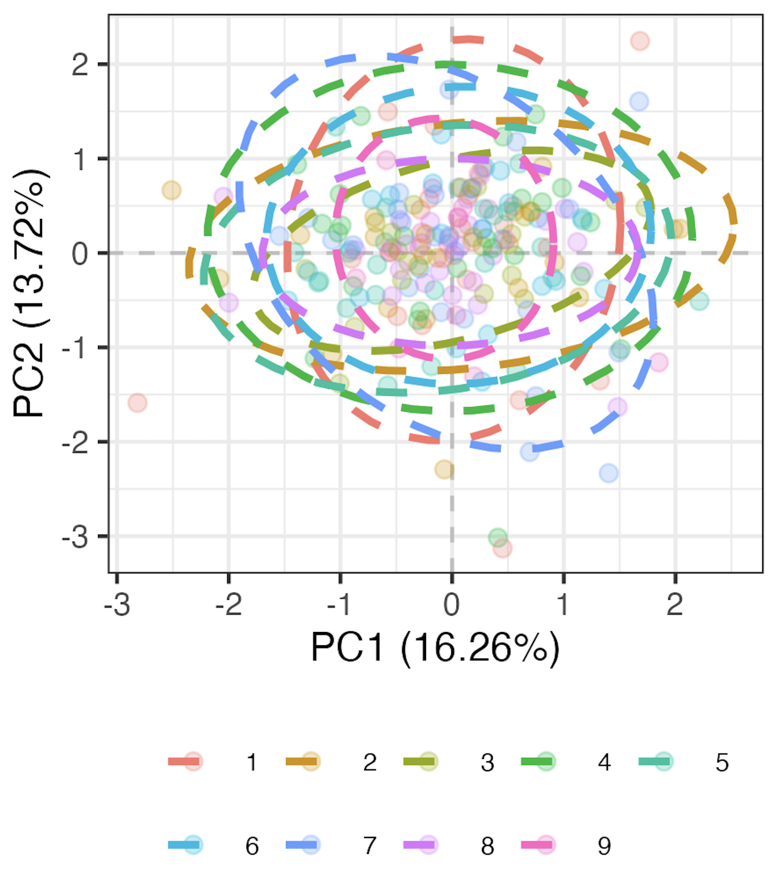
Methods for processing gated data
Make sure to explain well
Residuals
Transformation
Remove 9 subsets with high technical variation
Transform percent of parent data to be more normally distributed
Run mixed-effects LM for each of 71 remaining subsets, take residuals as batch-corrected data
Pre
Post
model <- lmer(freq ~ batch + (1|patient_id))
Batch
Batch
13
Notes:
Logit transforms 0-1 to –inf, inf to normalize data
This is likely overcorrecting but no better idea (yet)

Slide 14
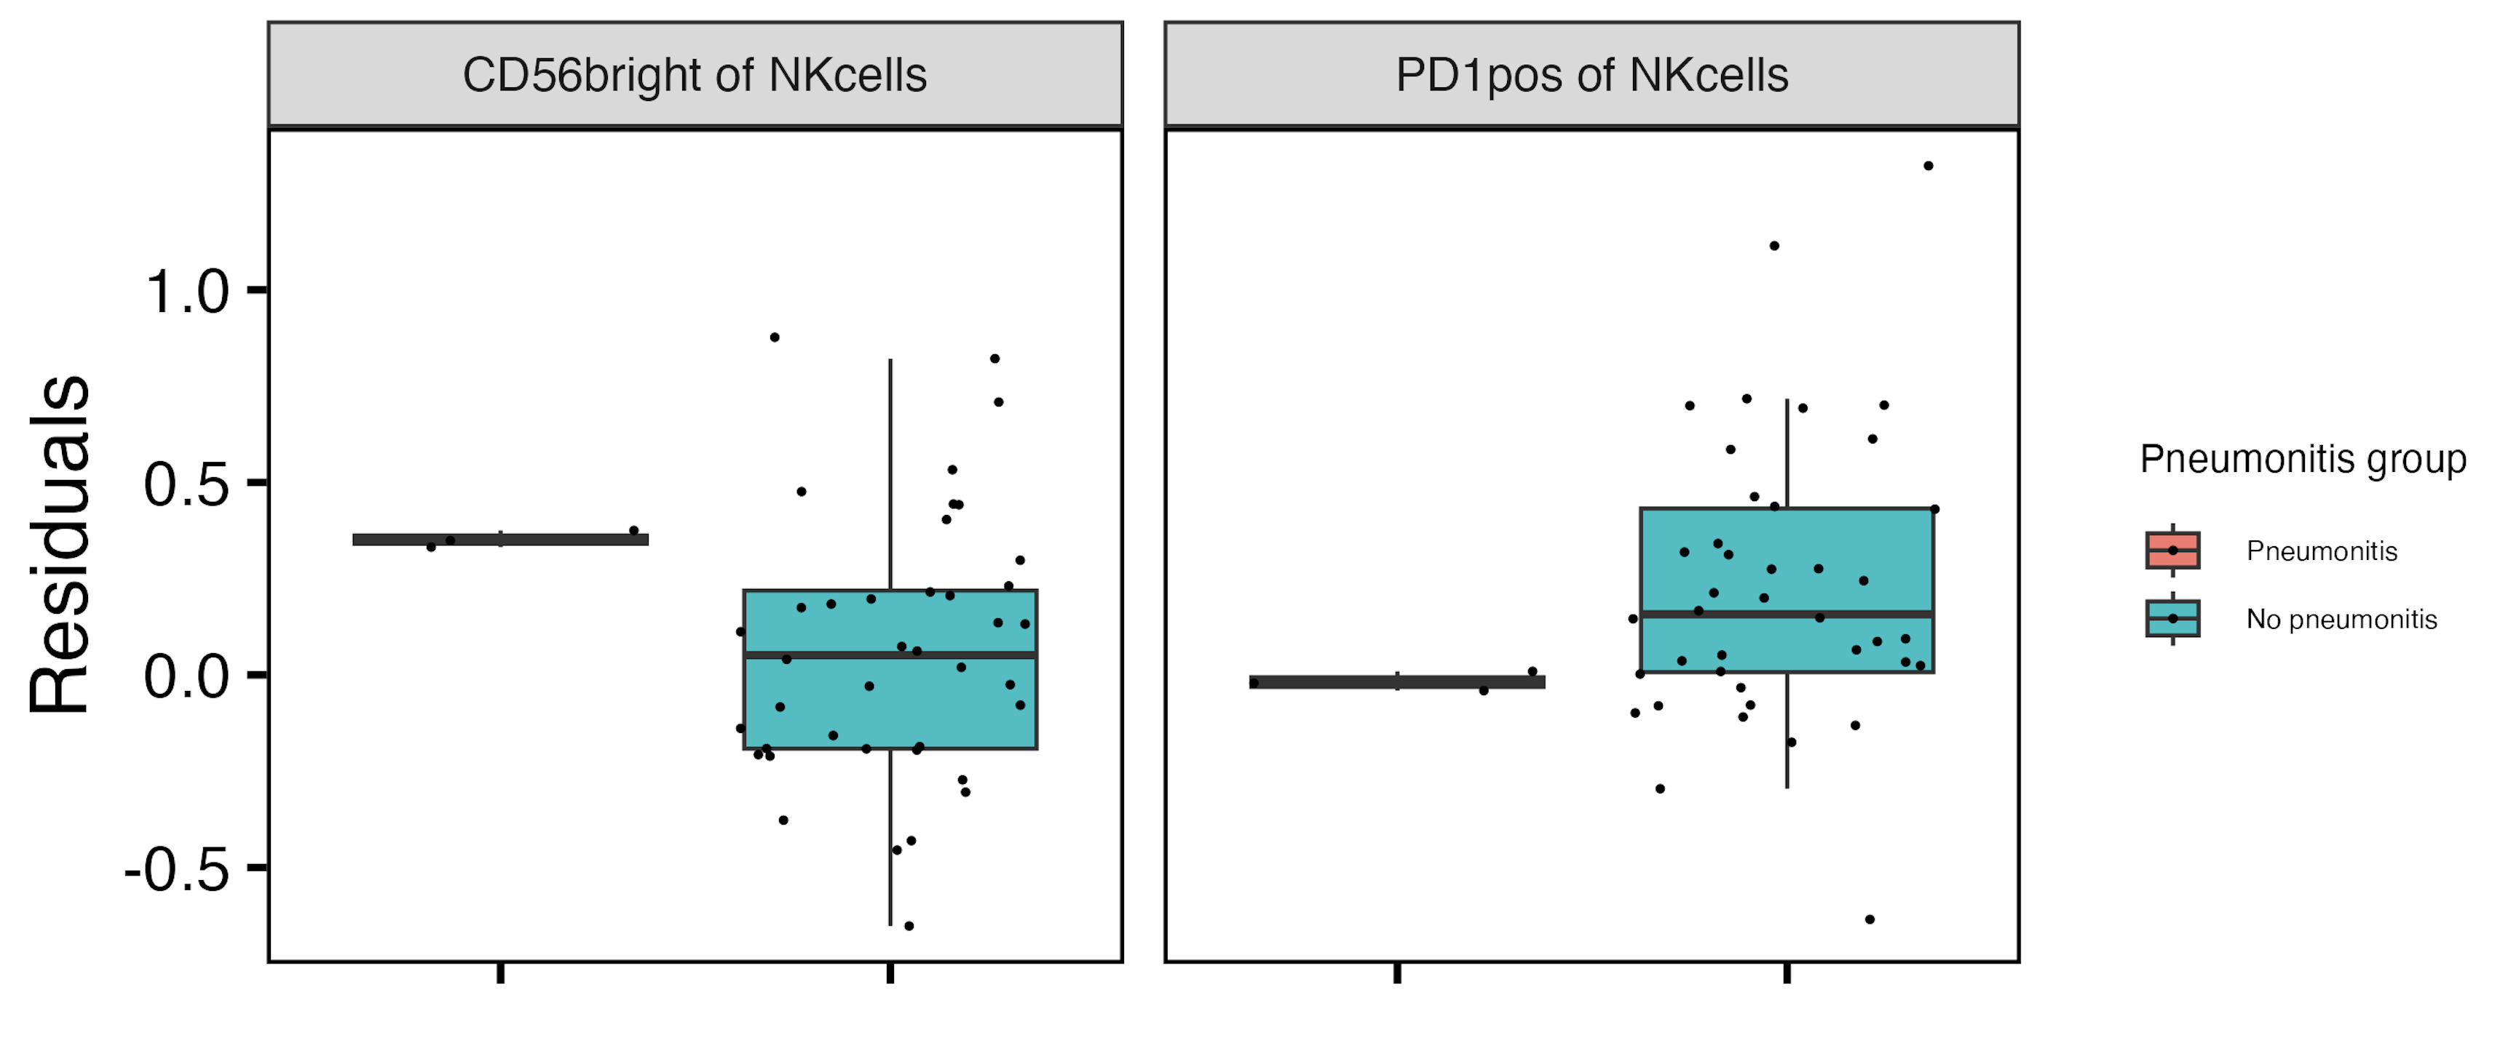
Baseline CD56^{bright} of NK cells frequency higher, PD1⁺ of NK cells frequency lower in those developing pneumonitis
**
**
Verbally: this is strongest single feature baseline result
14
**: padj < 0.01
Notes:
CD56bright NK are abundant cytokine producers but only weakly cytotoxic before activation, PD1+ NK presumably more inhibited…, so these trends could sense with more active → more irAE and more inhibited → less irAE BUT that doesn’t really fit with longitudinal decrease in CD56bright of NK in irAE group…
Only CD56bright of NK result holds if including pleural effusion in pneumonitis group

Slide 15
Methods for baseline subset modules
For each irAE group comparison
Rank subsets by importance
if irAE group has sufficient n, use random forest models to order subsets by importance in irAE group distinction
otherwise for each subset test for difference in baseline frequency distributions between irAE groups and arrange by pval
Take top 4 subsets as top subset module
PCA only using subsets in the module
Is vague
Need whole slide on 1ai (verbal just for combined) and 1aii (verbal done for all)
16
Notes:
For subsets with < 5% NAs, replace NAs with mean
random forest modules may be more robust, maybe more recapitulated in other datasets... that can explain differences between them and original modules (more likely over fit)
Should also emphasize that modules are somewhat arbitrary in sense that multiple different configurations of mostly same subsets would likely work for each module approach taken here

Slide 16
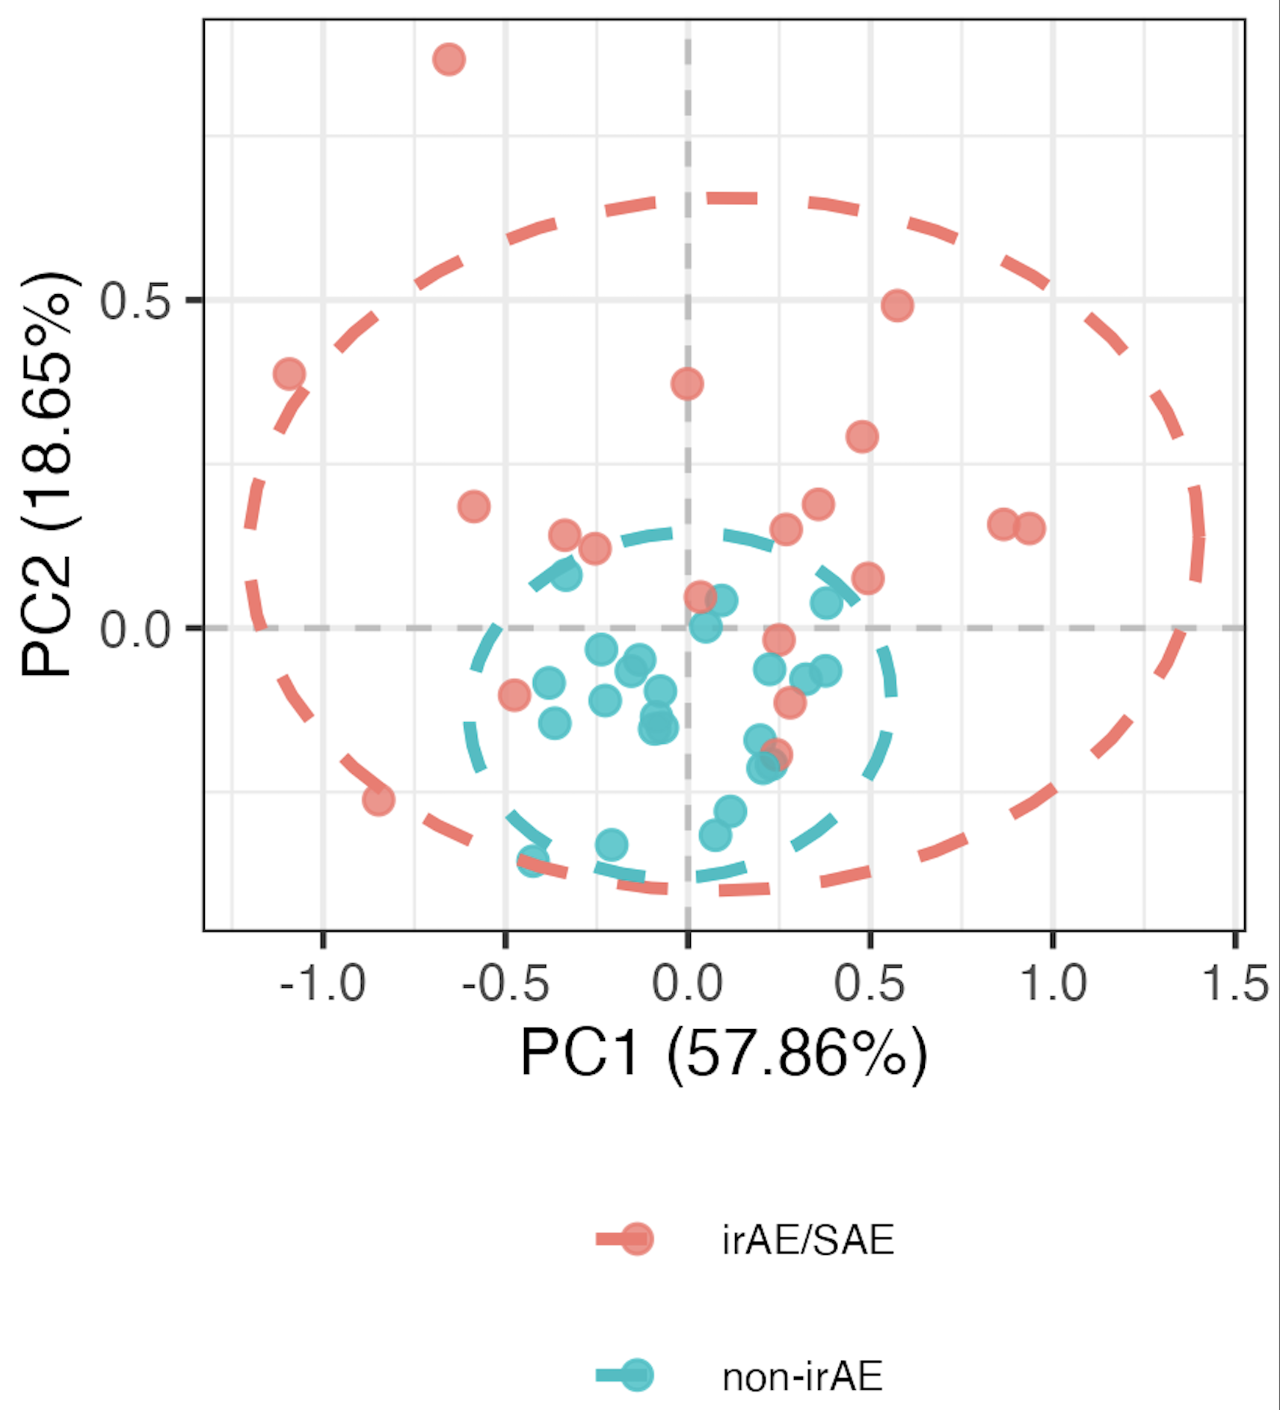
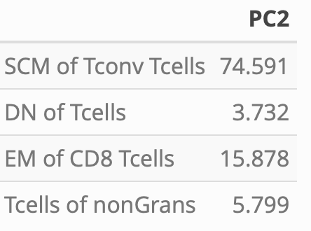
Distinguishing combined irAE group using random forest-derived module of top 4 combined irAE baseline subsets
PC2 weights
PC2 **
17
**: p < 0.01

Slide 17
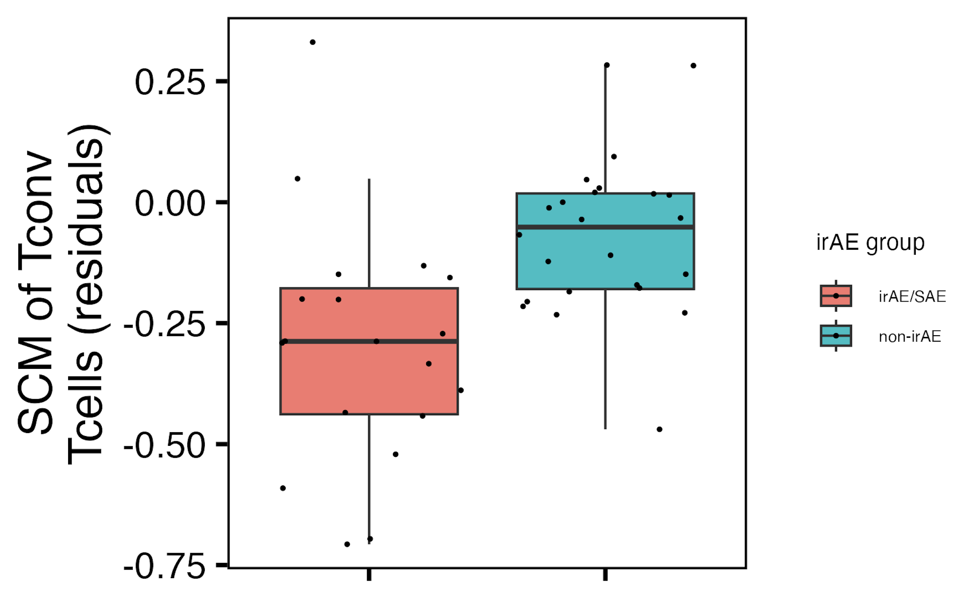
Baseline SCM of T_{conv} T_{cells} frequency may be lower in those developing an irAE
15
padj = 0.1
Notes:
This may be unexpected… expected SCM to be associated with pathogenic autoimmunity

Slide 18
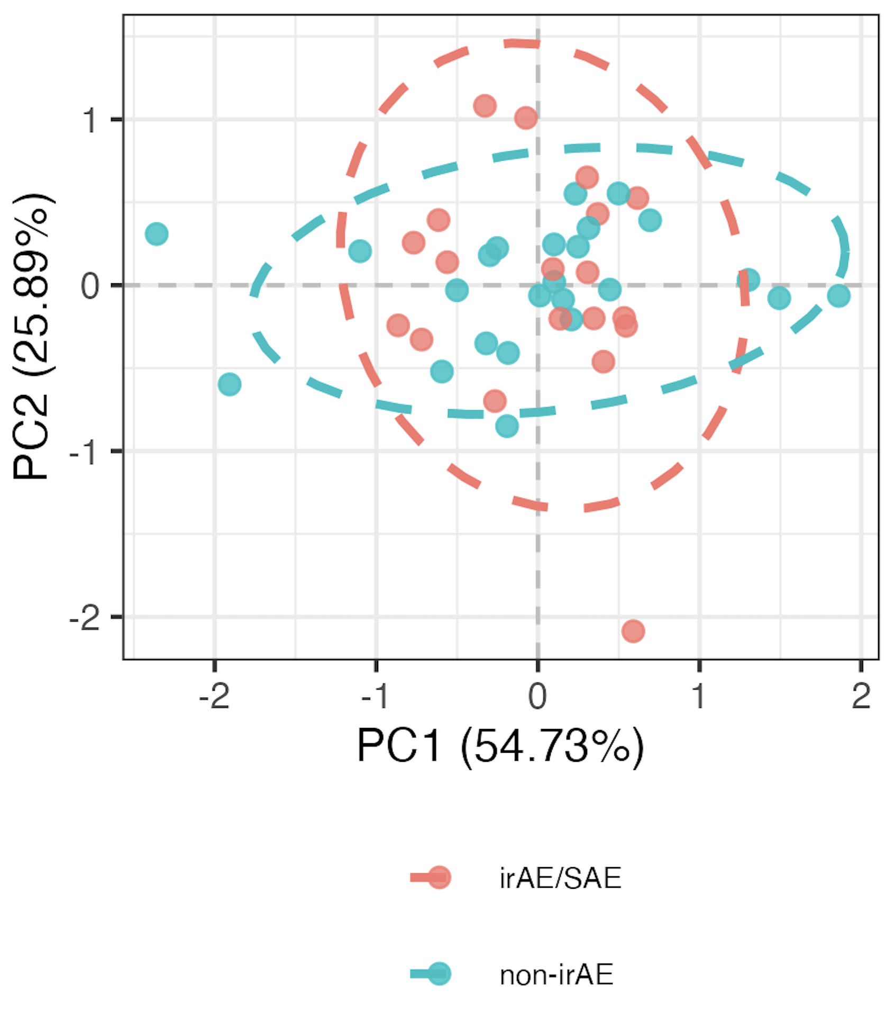
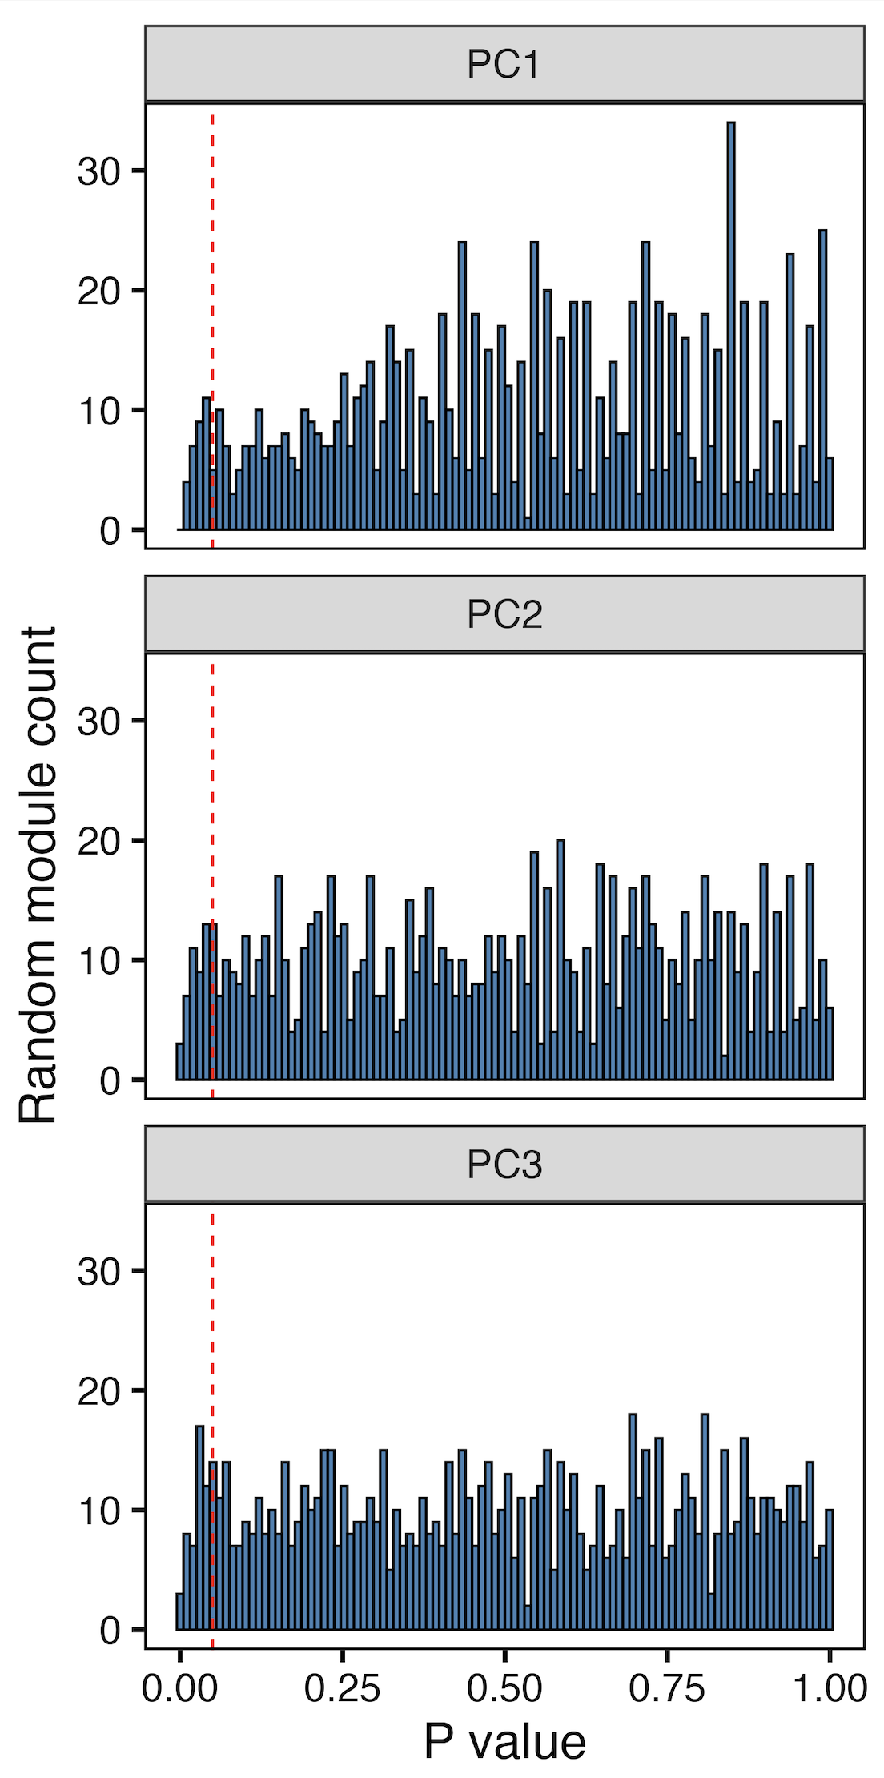
Distinction of combined irAE group using module of top 4 combined irAE baseline subsets unlikely due to chance
“bottom” 4 subset module
n.s. in PCs 1-3
18
Notes:
~4% of randomly formed modules have similar/better separation in PCA space, so this equates to a Monte Carlo pvalue of 0.04 which means that the observed separation using the top module on the previous slide is not likely due to random chance
SCM subset most common in sets of 4 that hit significance, not surprisingly given it’s a borderline pval itself…

Slide 19
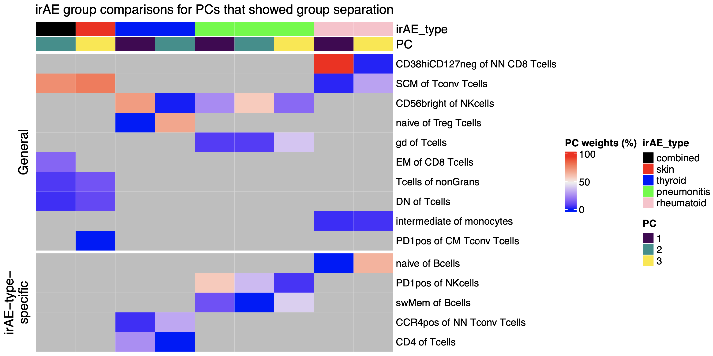
Summary of baseline module analyses: several subsets may be more irAE-type-specific
* Any subsets that have relations to
ICI-irAE literature
Vertical black dotted lines between red/blue
And green/pink (to show 3 vertical blocks)
Grey means NA (subset not in top module for that irAE group comparison)
19
Notes:
Worth raising concern of overfitting to our data (i.e. subsetting subsets ~arbitrarily), but the non-specific subsets with literature evidence are perhaps more backed up here (less biased by noise)
Only showing PCs with p < 0.05 for group comparison

Slide 20
Main goals
Identify immune cell biomarkers that predict irAEs
Determine how ICI alters immune cell landscape: what immune cell subsets change in irAE group-specific manner on ICI?
20

Slide 21
Methods to identify immune cell subsets changing over ICI in irAE group-specific manner
Remove PD1⁺ subsets (interference b/w PD1 block Ab and CyTOF Ab…
For each subset
Model relationship between subset frequency and time (since baseline) with or without interaction between irAE group and time (bolded)
Run ANOVA on two models to see if including interaction term improves model fit
model <- gam(freq ~ irae_group +
s(days_from_baseline, k = 5, bs = "cr", by = irae_group) +
s(patient_id, bs = "re"), data = data, method = 'REML')
24
Notes:
If model fit improves with interaction term (which ANOVA is testing), that means that the effect of time on ICI on subset frequency is different between irAE groups
Null hypothesis: The model without interaction (i.e., the simpler model) fits the data as well as the model with the interaction.
Alternative hypothesis: The model with the interaction term fits the data significantly better than the model without it, suggesting that the effect of days_from_baseline differs between groups.
REML (Restricted Maximum Likelihood) is a statistical technique used for parameter estimation, particularly in mixed-effects models and generalized additive models (GAMs)

Slide 22
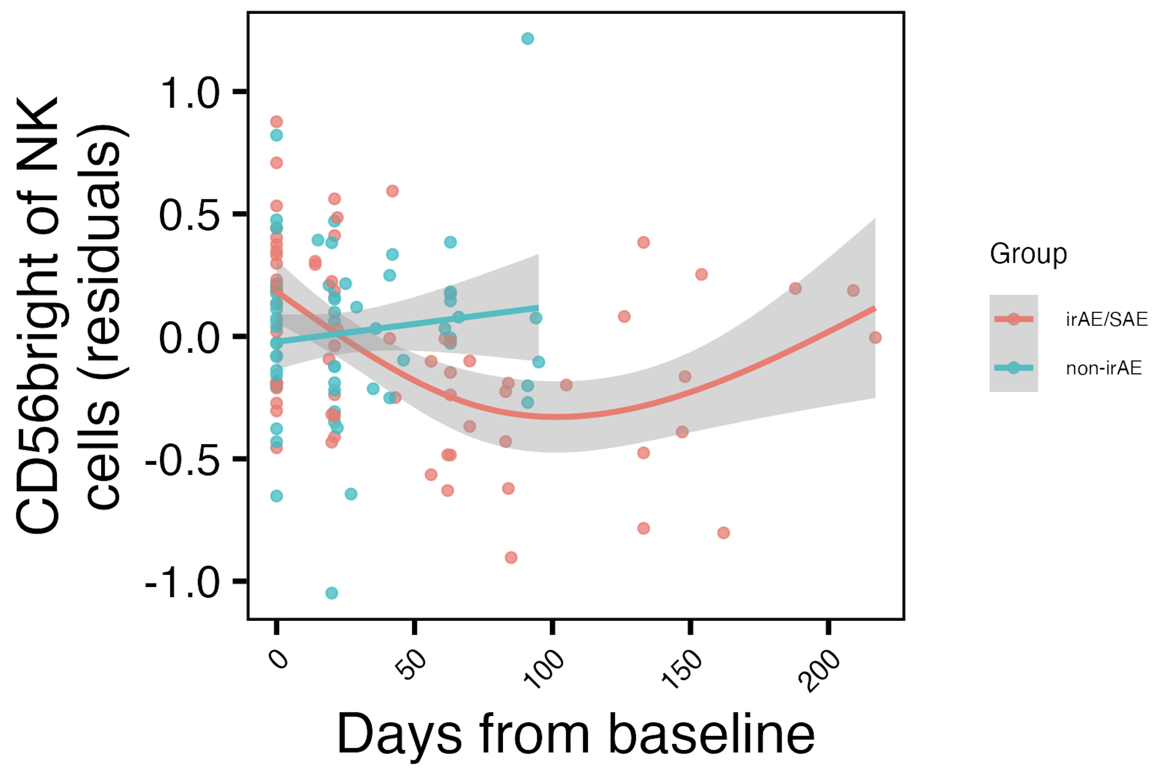
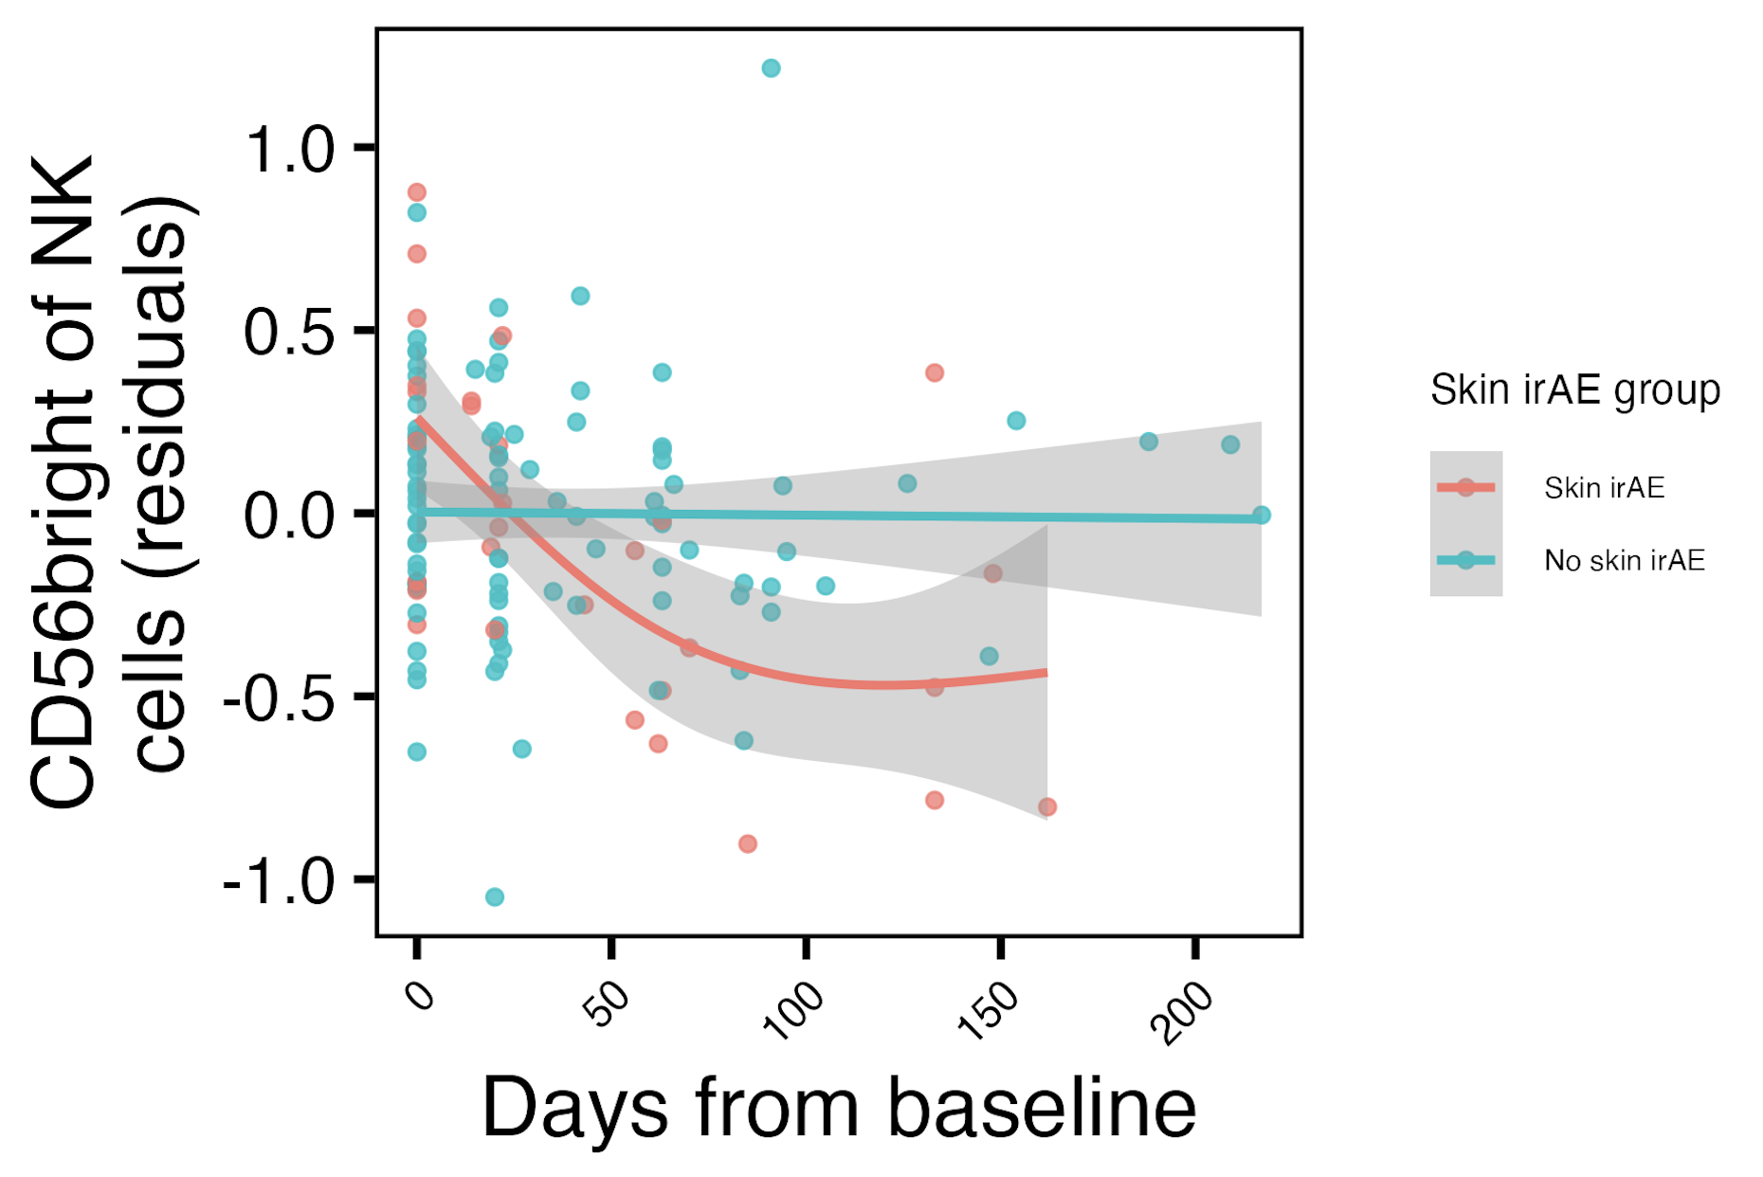
Frequency of CD56^{bright} of NK cells initially decreases with ICI specifically in combined irAE and skin irAE groups
Show all irAE group comparisons for this feature, group data and facet by irAE group comparison
Verbal: most robust longitudinal result
**
*
CD56^{high} NK of non-granulocyte frequency reported lower in severe irAE patients at irAE time (Kovacsovics-Bankowski et al. J Immunother Cancer. 2024)
25
**: padj < 0.01, *: padj < 0.05
Notes:
Note that remember from cohort metadata plot most irAEs arise within 1-2 months, so that’s within early timing here where we see differences
matches finding from Kovacsovics-Bankowski et al. J Immunother Cancer. 2024 (lower CD56high NK of non-gran in patients at irAE max), surprisingly despite their cohort was mostly not pulmonary irAE and was mostly melanoma!
Presumably longitudinal results that are group specific come from effects on PD1+ cells that then affect these other subsets we are actually measuring…

Slide 23
Summary
Make 1/2 more like 3: full sentences of very general
summaries
Baseline analyses
CD56^{bright} of NK cells frequency higher, PD1⁺ of NK cells frequency lower in those developing pneumonitis
SCM of T_{conv} T_{cells}
frequency may be lower in those developing irAEs
important subset in module for distinguishing combined irAEs
Longitudinal analyses
Immunotypes of irAE group do not clearly become more “AID-like” over ICI than those of non-irAE group
CD56^{bright} of NK frequency initially decreases with ICI in skin/combined irAE groups
Some subsets may be more irAE-type specific
26
Notes:
irAE-type-specific subsets, like CD56bright/PD1+ of NK for pneumonitis (and SCM of Tconv being more general maybe for combined irAE)
Cancer types important, as that (in addition to irAE types) will likely help explain differences in results between here/public reports (memory CD4 T cells may be more predictive in patients with melanoma while CD8 effecter T cells maye be more associated with a lung cancer population)
Different subsets maybe are irAE-type-specific due to different immune microenvironments of different organs
Presumably longitudinal results that are group specific come from effects on PD1+ cells that then affect these other subsets we are actually measuring…

Slide 24
Model: CD56bright NK cells traffic out of blood to irAE sites in response to changes in PD-1⁺ immune cells on PD-1 blockade, contributing to irAE development
Make a schematic
NKs in synovium of RA patients exhibit CD56^{bright} phenotype (Pridgeon et al. Rheumatology 2003)
CD56^{bright} subset of NKs greatly expanded within inflamed joints of patients with inflammatory arthritis (Dalbeth & Callan Arthritis & Rheumatology 2002)
CD56^{bright} NK cells enriched at inflammatory sites in variety of diseases (Dalbeth et al. J Immunol 2004)
CD56bright NK cells accumulate in psoriatic skin and exacerbate inflammation (Ottaviani et al. Eur J Immunol 2006)
27
Notes:
Changes in PD-1+ cells being here (potentially) signaling changes, chemokine production changes, recruitment signal changes.
And maybe higher baseline levels means larger reservoir to traffic out and cause damage?

Slide 25
Next steps
IMPACD to look at more granular cell subsets
Over ICI, do immunotypes become more “AID-like” more so in irAE group?
28
Notes:
LDA/QDA are supervised methods that find linear combinations of subsets that maximize class separability.
IMPACD stage 2 gating is what I am referring to I believe for more granular subsets: performs exhaustive permutational analysis of all markers. This resembles what we just did for stage 1, but instead of stopping after the first node, in stage 2 we will keep adding more and more nodes until a specified depth is reached.
Alice W. working on single-param gates to send my way
Public data test is likely ~complicated by needing similar cohorts to see same effects
But public data test would be very important given concerns of overfitting… for the module analysis

Slide 26
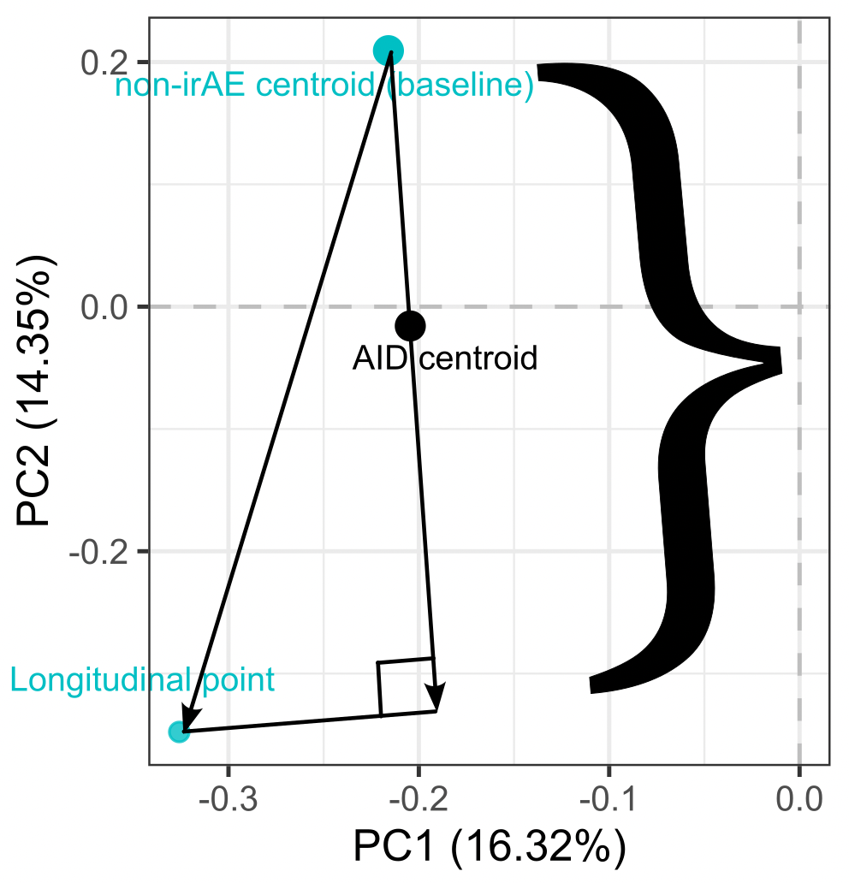
Over ICI, do immunotypes become more “AID-like” more so in irAE group?
component
of ICI effect
in direction of AID
Add version of that but for irAE not non-irAE
Replace } with ]
21
PCA just used to help visualize method
Notes:
Remove PD1⁺ subsets
Find centroids of autoimmune and baseline cancer data (for irAE/no irAE groups) in original high dimensional space
Define lines from baseline cancer centroids (irAE/no irAE ones) to/through autoimmune centroid
For each patient for each longitudinal sample, draw line from their baseline group centroid to that data point
Find component of those lines (step 4) in baseline-AID line (step 3), more positive meaning more in direction of AID immunotype
Longitudinal data, draw schedule: visits 2/3 after 1st/2nd infusion (ICI)
So we’re doing projection of vector from cancer baseline centroid to longitudinal point, projection of that onto vector from centroid of baseline cancer to AID centroid
Hard to say but would be important/nice to know at what projection value they’ve “passed” the AID centroid… which may or may not be biologically interesting…

Slide 27
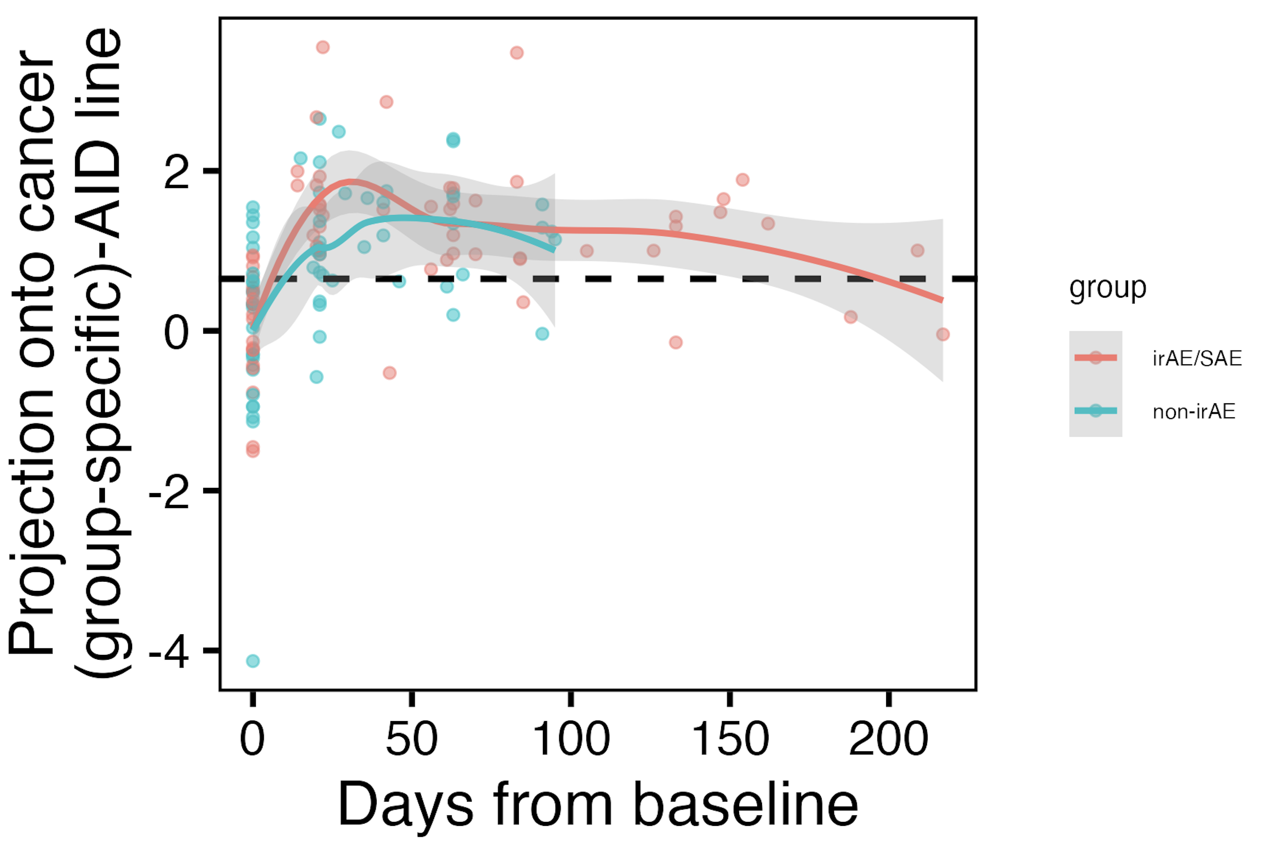
Immunotypes of irAE group do not clearly become more “AID-like” over ICI than those of non-irAE group
Dotted line showing baseline cancer centroid-AID centroid distance
n.s.
22
Notes:
THIS IS NOT SIGNIFICANT, BUT MAY BE INTERESTING NONTHELESS?
Note that remember from cohort metadata plot most irAEs arise within 1-2 months, so that’s within early timing here where we see differences
And the fact that you can see returning to baseline in the late timepoint data makes sense I think
positive means closer to AID centroid
Hard to say but would be important/nice to know at what projection value they’ve “passed” the AID centroid… which may or may not be biologically interesting…

Slide 28
Inhibitory immune checkpoints help maintain self tolerance
Khan et al. Semin Cancer Biol. 2020
Notes:
Script:
Immune checkpoint molecules are ligand-receptor pairs that exert stimulatory or inhibitory effects on the immune response
Inhibitory checkpoints are crucial for maintaining self-tolerance and modulating the duration and magnitude of the immune response to minimize tissue damage
CTLA-4 and PD-1/PD-L1 are the most widely studied inhibitory checkpoint molecules.
CTLA-4 outcompetes CD28 (costimulatory receptor) for B7-1/2 ligands on APCs to increase threshold for T cell activation (i.e. reduces immune responses to weak antigens, self/tumor)
PD-1 expressed by activated/induced T cells; this checkpoint prevents inappropriate overactivation and limits duration of T cell activation

Slide 29
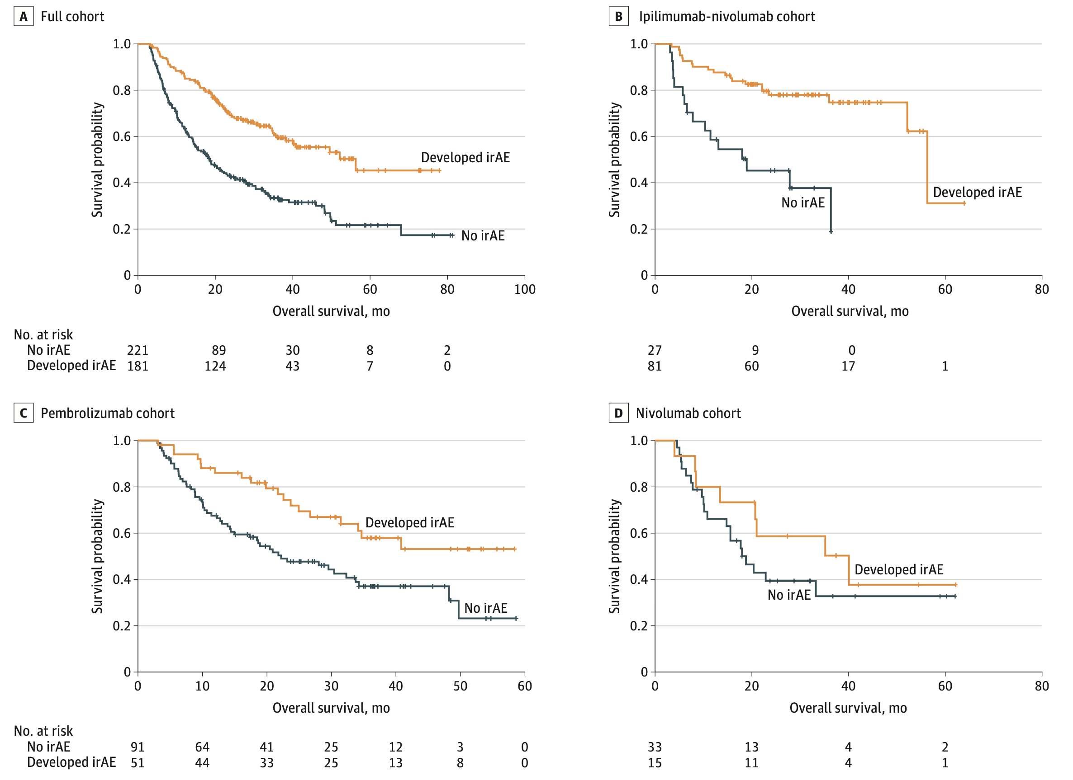
irAE development is associated with anti-tumor response (PMID31021392, PMID26501224, PMID26446948)
Watson et al. JAMA Netw Open. 2022
Notes:
Association of checkpoint inhibitor-induced toxic effects with shared cancer and tissue antigens in non-small cell lung cancer:
irAEs associated with response to therapy (also can cite Association of vitiligo with tumor response in patients with metastatic melanoma treated with pembrolizumab), also Nivolumab in resected and unresectable metastatic melanoma: characteristics of immune-related adverse events and association with outcomes
Characterization of anti-cancer immune response associated with immune-related adverse events in patients with kidney cancer (meeting abstract)
- more irAEs in ICB responders, not a new finding

Slide 30
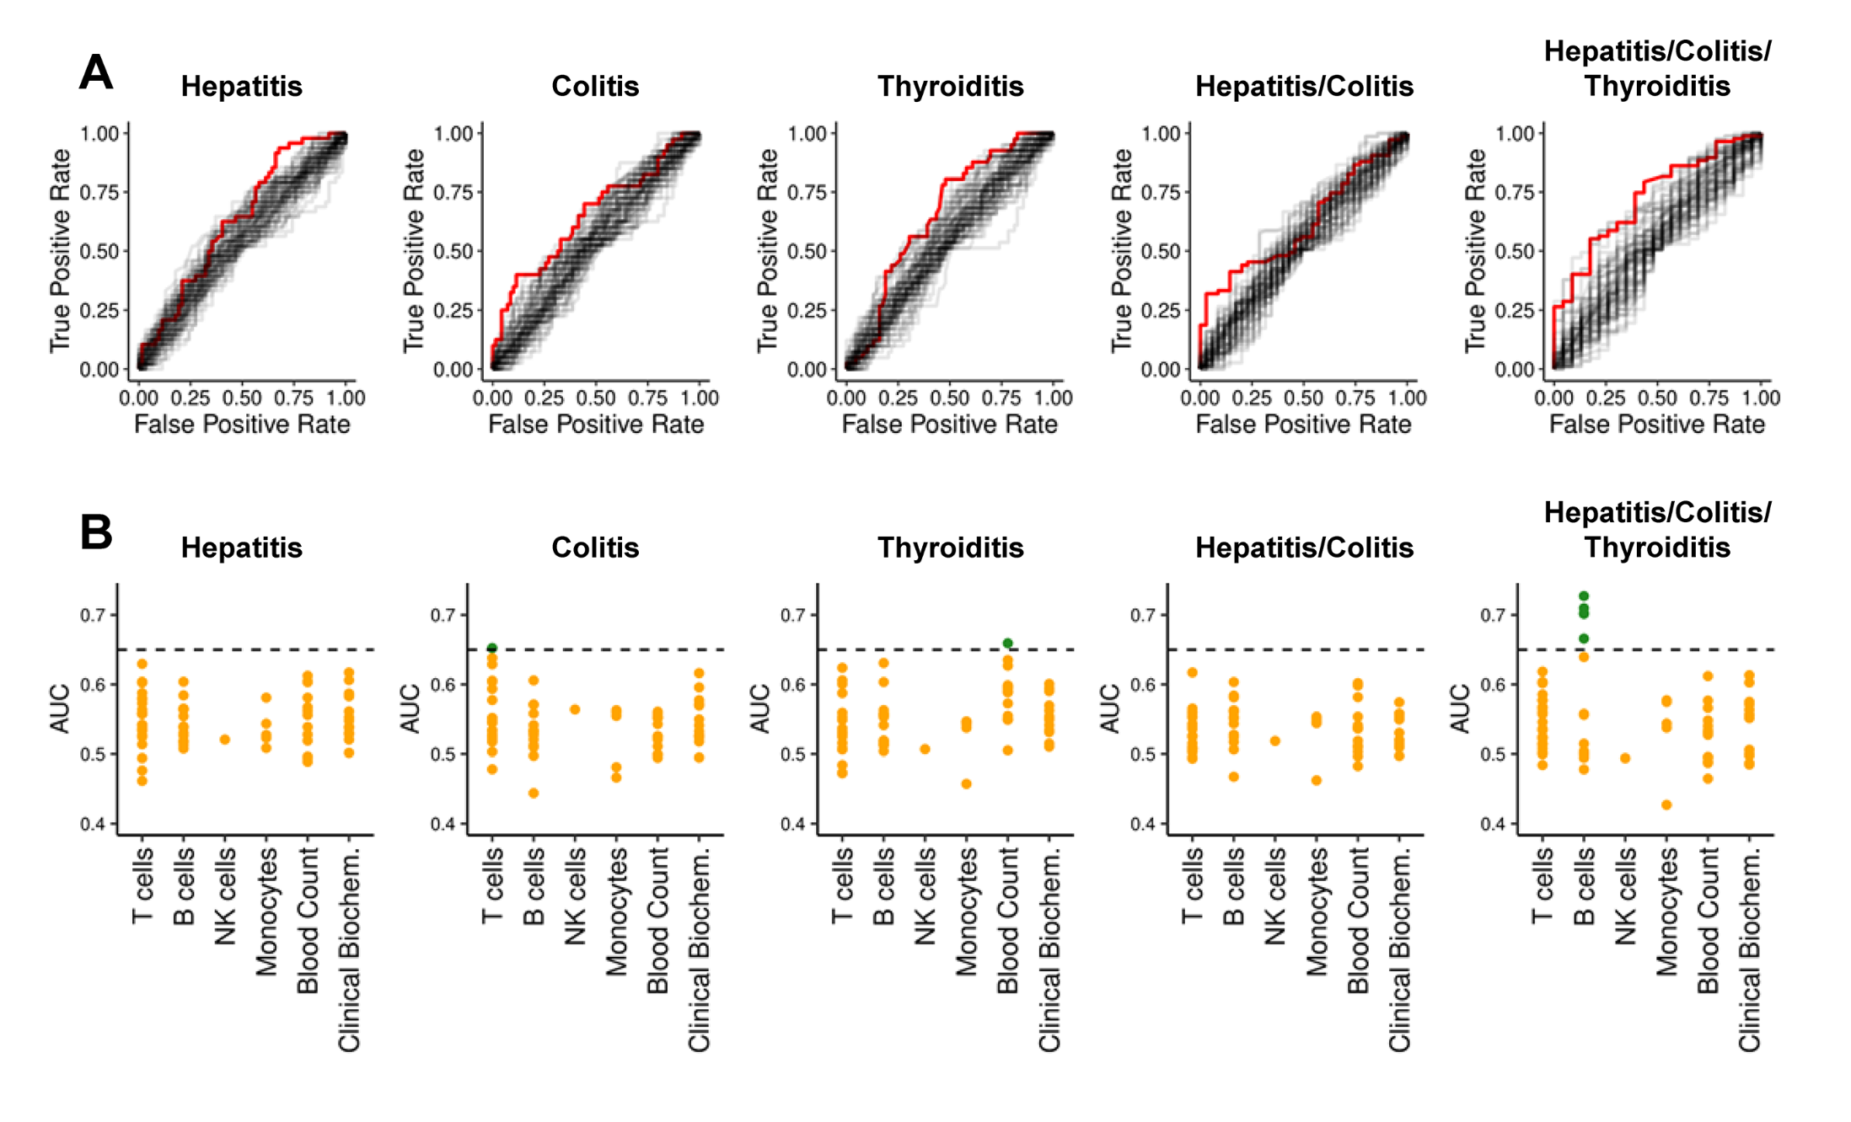
Pre-therapy data generally struggle to reliably predict irAE risk
AUCs for previously reported biomarkers and clinical parameters (68)
Glehr et al. Front Immunol. 2022
Notes:
Biomarkers associated with irAE have also been described, including IL-17 levels, gene expression signatures and levels of eosinophils, but hard to predict specifically from pre-therapy data
An AUC of 0.5 suggests no discrimination (equivalent to random guessing), while an AUC of 1 indicates perfect discrimination (for predicting irAE)

